Slide 1
Masters | Resources Overview
Masters Performance Scorecard – Tracks actuals vs goal performance across data periods. Drills into Rep, Channel, Product, and Account level detail and trends
Masters Finance Dashboard – Primary Masters sales dashboard reporting units, sales, and gross profit down to the customer and product levels
Masters Performance Insights – Focused on identifying recent profitability drivers across reps, channels, customers, and products
Masters FY25 KPI Tracker – Tracks progress to FY25 initiatives (new customer acquisitions, growth, web utilization, NSTAR growth, leakage, etc.)
Masters Incentive Tracker – Provides visibility into compensation-based performance
IQVIA Leakage Dashboard – IQVIA leakage opportunities (not Masters specific but leverage by Masters team)
Masters Productivity Report – Excel monthly report providing ranking of rep productivity across key metrics (customers served, calls, talk time, etc.)
SSRS Pricing Reports – Suite of legacy reports (sent via subscription) set-up to provide Masters pricing team with sales & pricing data
Lead Channels:
Offboarding leads from Kyndra Krensavage, housed in Smartsheet.
Rejunction leads from Sales Solutions, sent by Jonathan Dennehy to Josh Davis, also housed in Smartsheet.
Tableau Dashboard BI leads, owned by Thad Bolline, running from a sandbox SQL table in Snowflake
Mastersrx.com leads from pharmacies submitting contact forms, verified by Craig Herget.

Slide 2
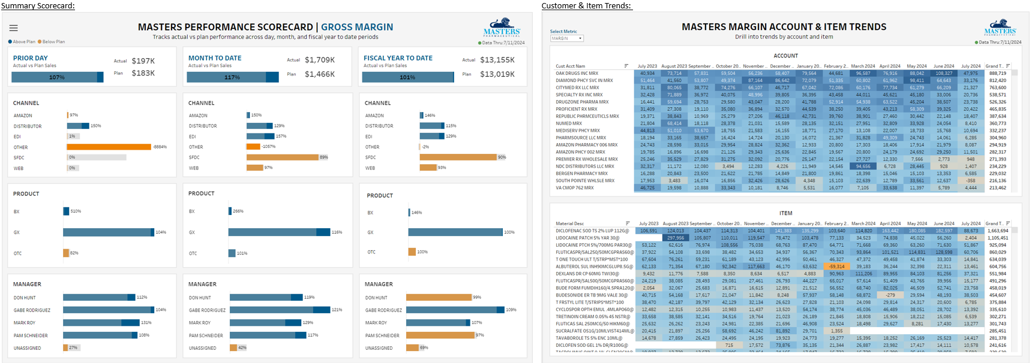
Masters | Performance Scorecard
Masters Performance Scorecard
Provides visibility into prior day, month to date, and fiscal year to date gross margin performance to goals across channel, product type, and by manager
Ability to drill into performance drivers or view customer and item level trends
Daily email snapshots provided to LT, Managers, & Sales Reps

Slide 3
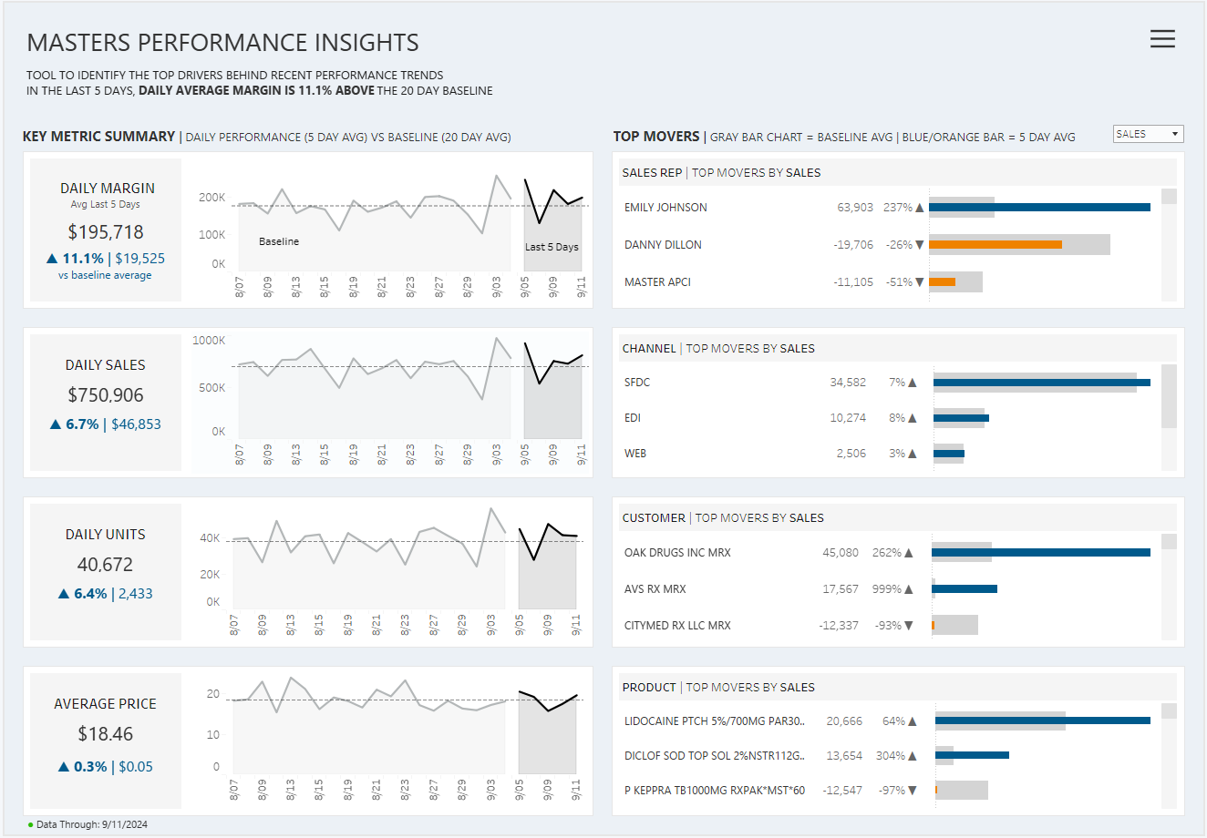
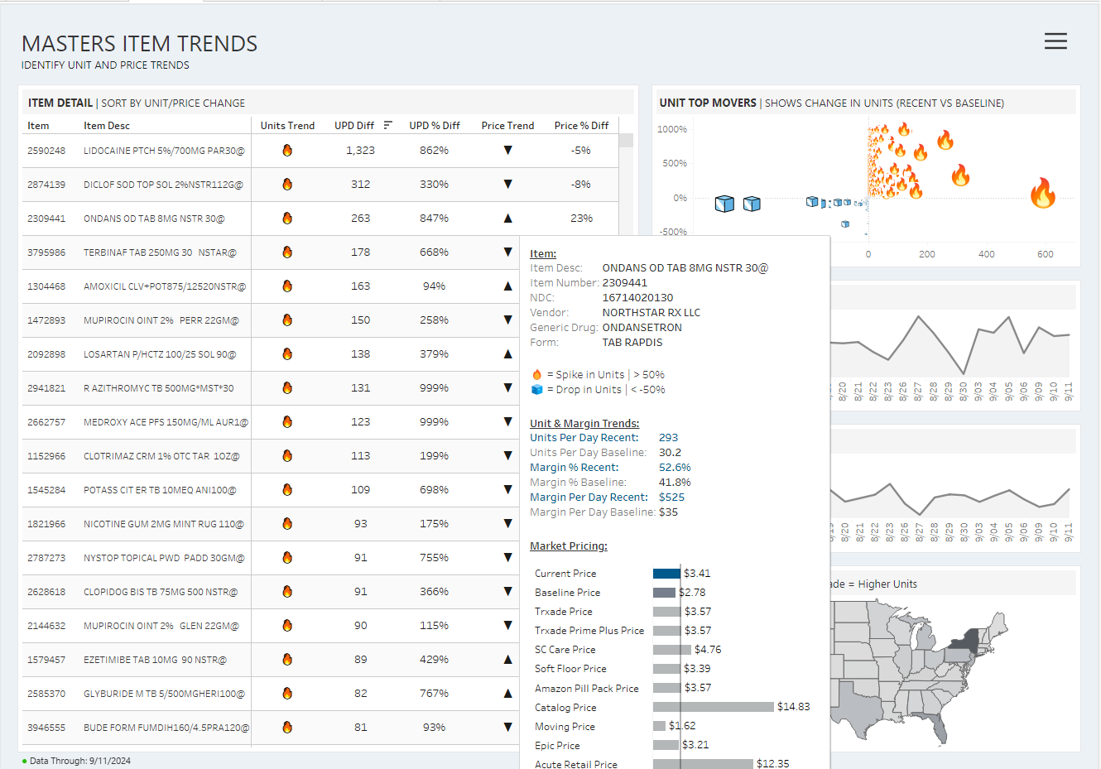
Masters | Performance Insights
Masters Performance Insights
Identifies recent gross profit drivers in comparison to baseline performance
Highlights products selling above/below baseline and provides visibility into market price points
MTD performance & actual vs goal tracking
Recent Performance Drivers:
Item Trends & Pricing Info:

Slide 4
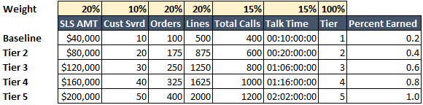
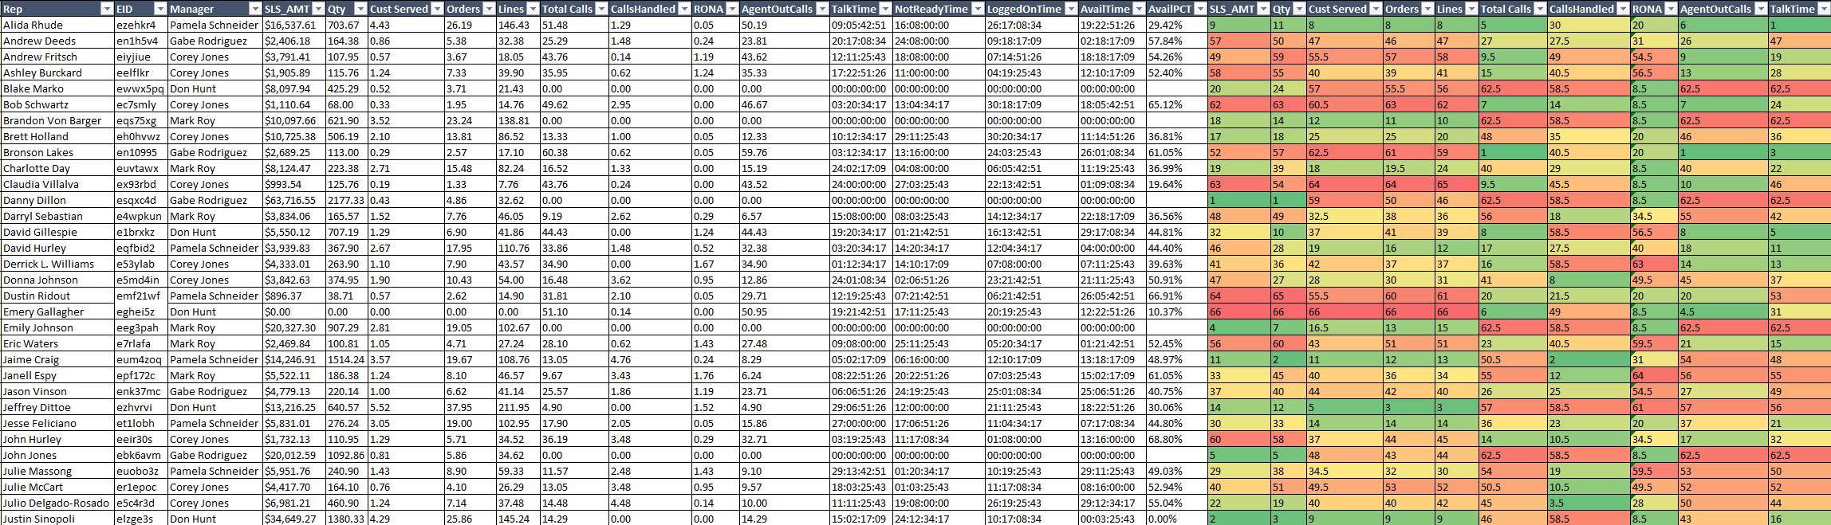
Masters | Productivity Report
Excel based report provided monthly by Sales Performance & Analytics Team
Tracks productivity of reps across key metrics (customers served, orders, lines, calls, talk time)
Request to automate and build into dashboard (move from monthly to daily data)

Slide 5
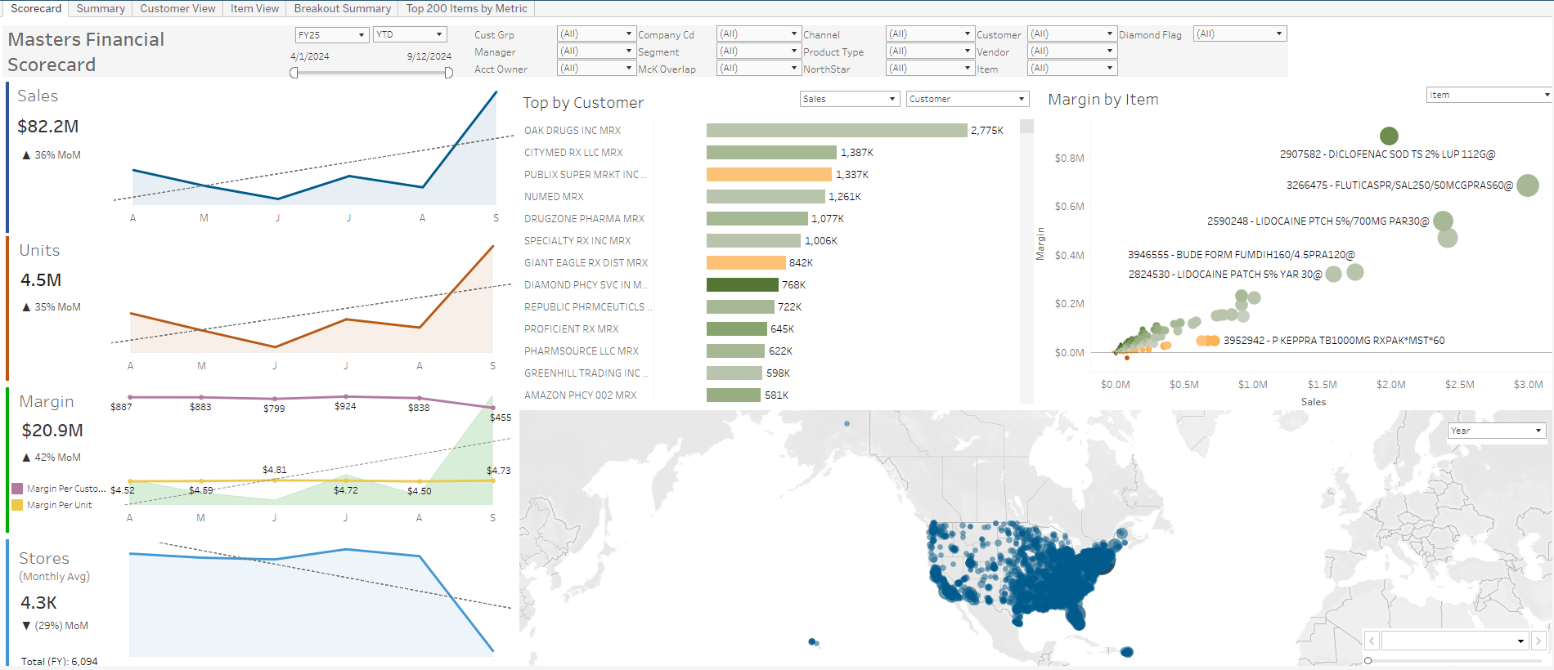
Masters | Finance Dashboard
Masters Finance Dashboard
Primary general sales performance dashboard
Sales, unit, ASP, & margin trends
Drill in channel, vendor, customer, & item level detail

Slide 6
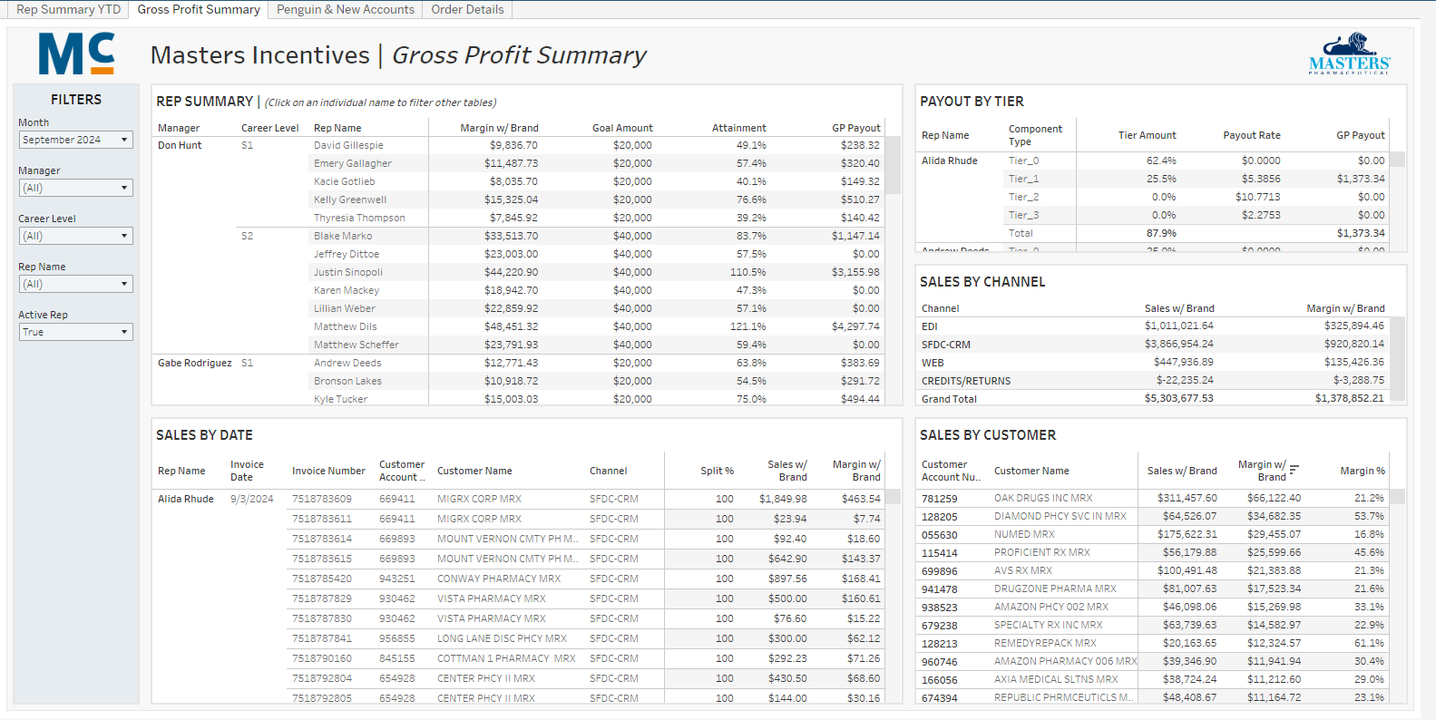
Masters | Incentives Tracker
Masters FY25 KPI Tracker
Provides visibility into compensation-based performance & respective payout estimates
User level security applied

Slide 7
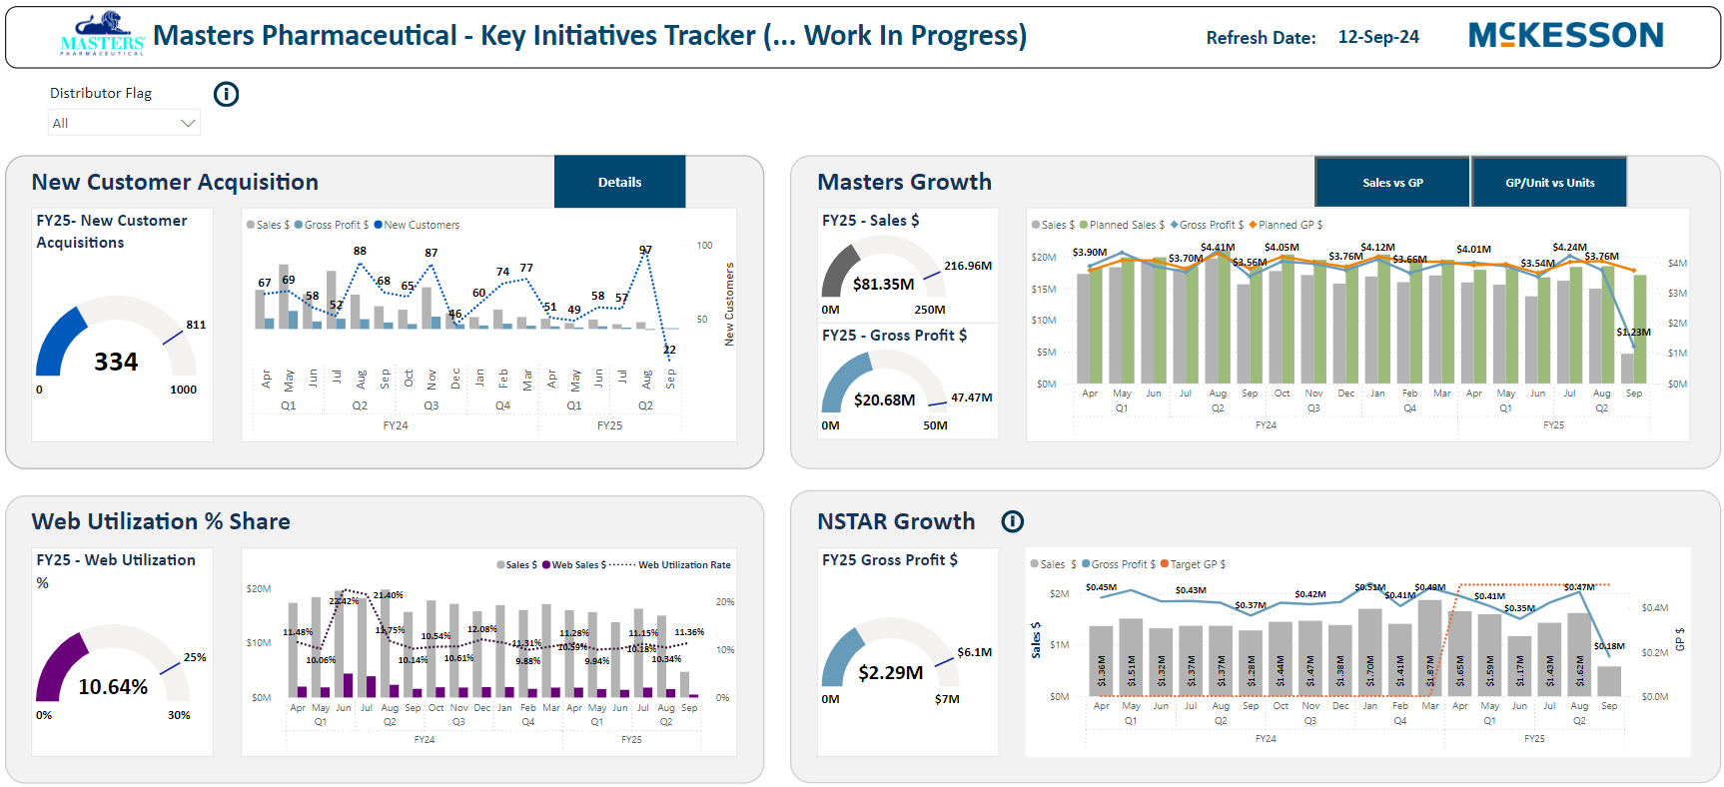
Masters | FY25 Initiatives Tracker
Masters Incentive Tracker
Progress towards FY25 goals across key initiatives
New customer acquisition, growth, web utilization, NSTAR growth, leakage, etc.

